Slide 1

Lecture 0
Module Start-up
Ethical Hacking
Diploma in CSF
Year 3 (2021/22), Semester 1
Notes:
Left-hand Bar – Replace FSP by your module code and X by the lecture number.
Replace Lecture Title
Replace < Module Name >
Replace Year and Semester if necessary

Slide 2
Contents
Goal of the module
To understand why Ethical Hacking
To establish how hacking can be ethical
To understand why Pen-Testing is important to Singapore
EH tutors
Learning Pedagogy
Attributes of a Professional Pen-Tester
Technology adopted for Delivery of EH

Slide 3
Goal of the Module
Develop the knowledge and skills(soft and hard) needed for “Hit-the-Road Running” Pen-Testers, stands for Penetration Testers
We do not hack, but we carry out penetration testing instead.
We call ourselves Pen-Testers.

Slide 4
Why Pen-Test?

Slide 5

To understand why the need for pen-test … we need to know the dangers…
This video is no longer available on YouTube. You may watch it in MeL.

Slide 6
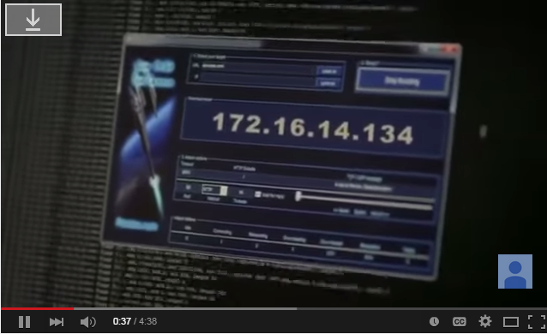
How organization can react to attacks and prevent attacks?
https://www.youtube.com/watch?v=v5EgFWJWdWk

Slide 7

Thinking Question 0.1
How hacking can be ethical?
(Use your class's MS Team – MS Spreadsheet to enter your Answers. Please complete before the beginning of next week class.)

Slide 8
Singapore Computer Misuse and Cybersecurity Act – Chapter 50a
Prohibits:
Access with intent to commit or facilitate commission of offence
Unauthorized access to computer materials
Unauthorized modification of computer materials.
Unauthorized use or interception of computer service.
Unauthorized disclosure of access code
Abetting any of the above.
Fine up to S$100,000 and imprisonment up to 20 years
https://sso.agc.gov.sg/Acts-Supp/22-2017/Published/20170511?DocDate=20170511

Slide 9

Thinking Question 0.2
Why is Penetration Testing important to Singapore’s organizations and businesses ?
(Use your class's MS Team – MS Spreadsheet to enter your Answers. Please complete before the beginning of next week class.)

Slide 10
EH Tutors
Mr. Tan Hock Guan (thg@np.edu.sg) – Module Leader
Mr. Mohamed Saifulamri Omar (Mohamed_Saifulamri_OMAR@np.edu.sg)
Mr. Arthur Tan (Arthur_TAN@np.edu.sg)

Slide 11
Learning Pedagogy

Slide 12
Non-Traditional Teaching Approach
Experiential Learning - Instructive cum Constructive
Lecturers provide you with the fundamentals and basic skills, students learn through practices and explorations.
Learner-Centered and Self-Directed Learning through Open Assignment on Hacking Devices/OS
There will be A LOT OF LEARNING from one and another
Incorporated with “Guided Mastery Learning” & “Flipped Classroom Learning” Approach
Weekly step by step guided practices and Penetration Testing assignment task(s), leading to master the art of Pen-Testing.
Students able to work on their own prior to classroom session.
Progressive weekly consultation and coaching to scaffold learning.

Slide 13
Remote Learning
Targeted at 25% of 60 Contact Hours – About 15 Hours (4 weeks)
Students will be advised in due time.
White-Space Week (Week 5 & Week 14)
Lessons will be asynchronous
Teaching and Learning (IMPORTANT)
Apart from weekly lessons, teaching and learning will also be going through coaching and consultation sessions in class.
Work closely with any of the Tutors.

Slide 14

Rationales behind the Non-Traditional Approach
Source: https://www.moe.gov.sg/education/education-system/21st-century-competencies

Slide 15
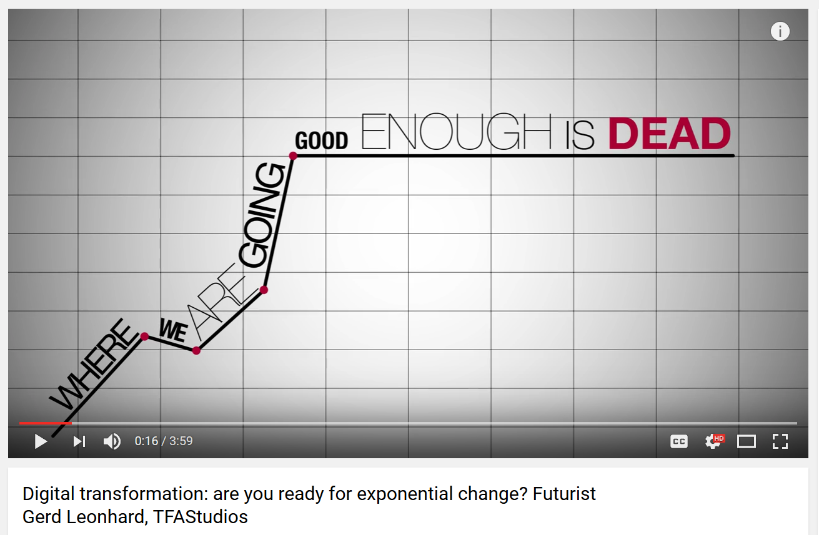
Source: https://www.youtube.com/watch?v=ystdF6jN7hc

Slide 16
Information
Assessment Scheme
Assignment (Team and Ind.) – 40%
Practical Test (Ind.) – 20%
Common Test (Ind.) – 30%
Class Participation-Performance Values Assessment (Ind) - 10%

Slide 17
Inculcation and Instilling of Values

Slide 18
NP Core Values – R3ICG
In line with NP’s expected Core Values in Student
Respect
Responsibility
Resilience
Integrity
Compassion
Gratitude

Slide 19
Performance Values for EH
Through Self-Claim Evidencing, Peers’ Appraisal & Tutor’s Observation
Follows Code of Ethics for Security Professionals
One Family Spirit
Reaching Out to One Another, Help One and Another
Respect One Another
Punctual and always be in the Classroom before the Tutor
Always be there for your Team, Work together and Learn together
Participate actively in Learning and Sharing and contribute to Class Learning
Follow Coursework Requirements cum Instructions for On-time Submissions
Regular Interactions and Constructive Feedback
Exhibit Positive Behaviors and Wear Proper Attires

Slide 20

Thinking Question 0.3
Identify ONE important Professional Attribute of a Pen-Tester? Provide a reason for the attribute that you have identified…
Use your class's MS Team – MS Spreadsheet to enter your Answers. Please complete before the beginning of next week class.

Slide 21
Platforms used in this module
Different platform has its Positive Points and Negative Points.
MeL – For mounting of EH related announcements, teaching and learning materials
MS Team (As backup to MeL) – For facilitating teaching and learning, and evidencing learning and experiences on EH
Module rept. will help to add names to the respective group 0419-EH-XXX and 0419-EH-ALL teams.

Slide 22
Pedagogy Component | What you have Learnt
Knowledge & Skills Construction | Goal of Ethical Hacking module. How to build “hit-the-road-running” Pen-Testers? Reasons for non-traditional teaching approach. Important teaching method – Constructivism. Instilling and inculcation of values and rationale.
Thinking | How hacking can be ethical? Why is Penetration Testing is important to Singapore businesses? What are the important Professional Attribute of a Pen-Tester and why?
Teaching & Learning | Instruction, constructive, collaborative and reflective learning.
Activities | Flipped classroom tutorial.
Feedback | Through discussions and sample answers.

Slide 23
End

